Slide 1
Linear Algebra
Lecture 9

Slide 2
Systems of
Linear Equations

Slide 3
Linear
Transformations

Slide 4
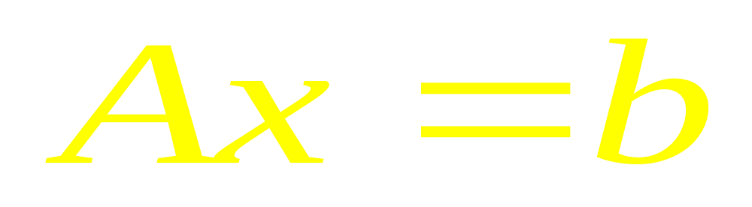
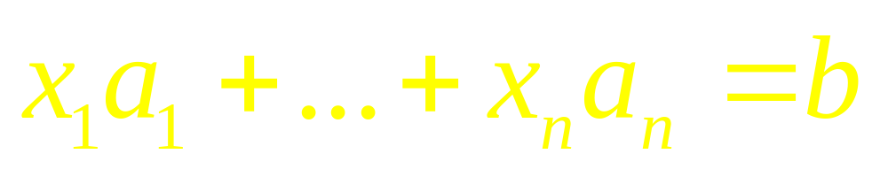
Matrix Equation
Vector Equation

Slide 5
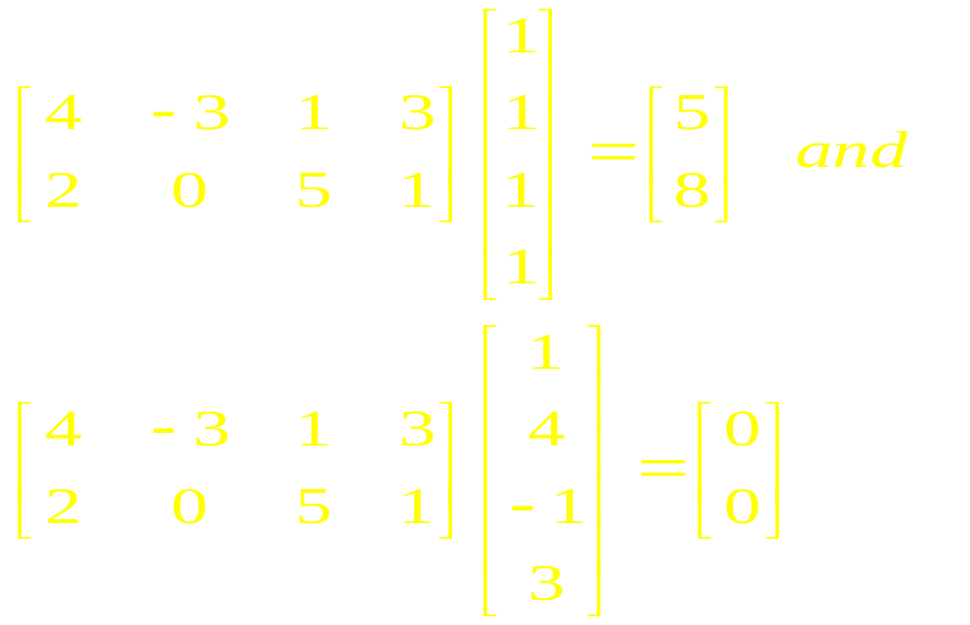
Observe

Slide 6
A Transformation
or Function
or Mapping

Slide 7
A transformation T from R^{m} is a rule that assigns to each vector x in R^{n} a vector T(x) in R^{m} . The set R^{n} is called the domain of T, and R^{m} is called the co-domain of T.

Slide 8

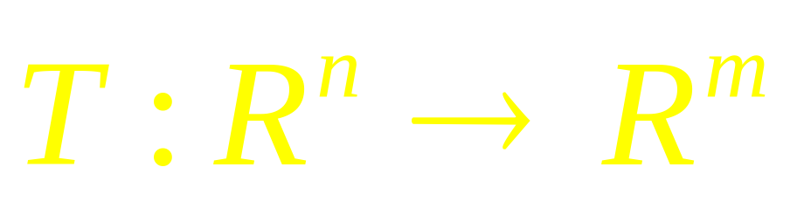
The notation
indicates that the domain of T is R^{n} and the co-domain is R^{m}. For x in R^{n} , the vector T(x) in R^{m} is called the image of x (under the action of T). The set of all images T(x) is called the range of T

Slide 9
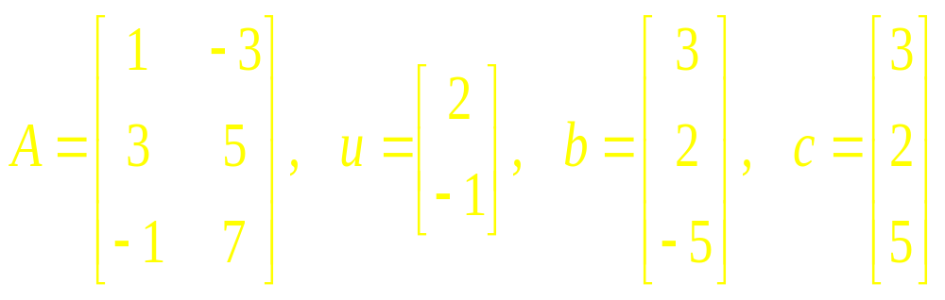
Example 1

Slide 10
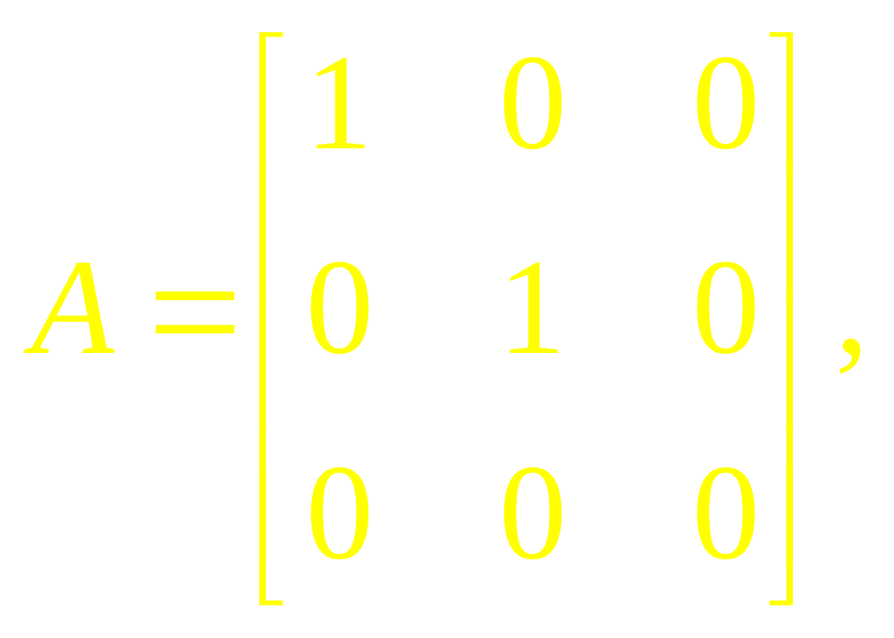
Example 2

Slide 11
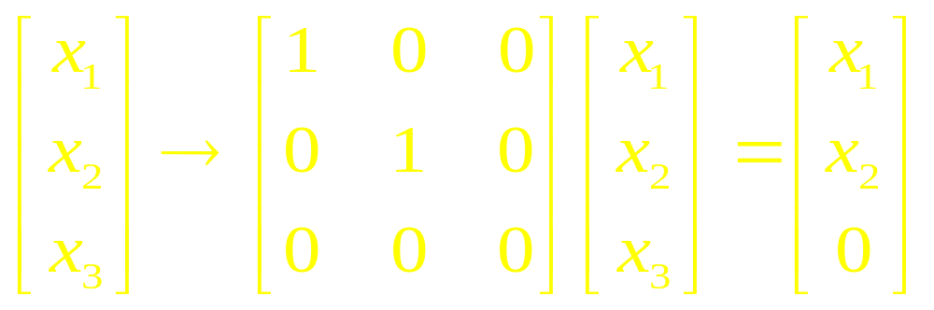
Example 2

Slide 12
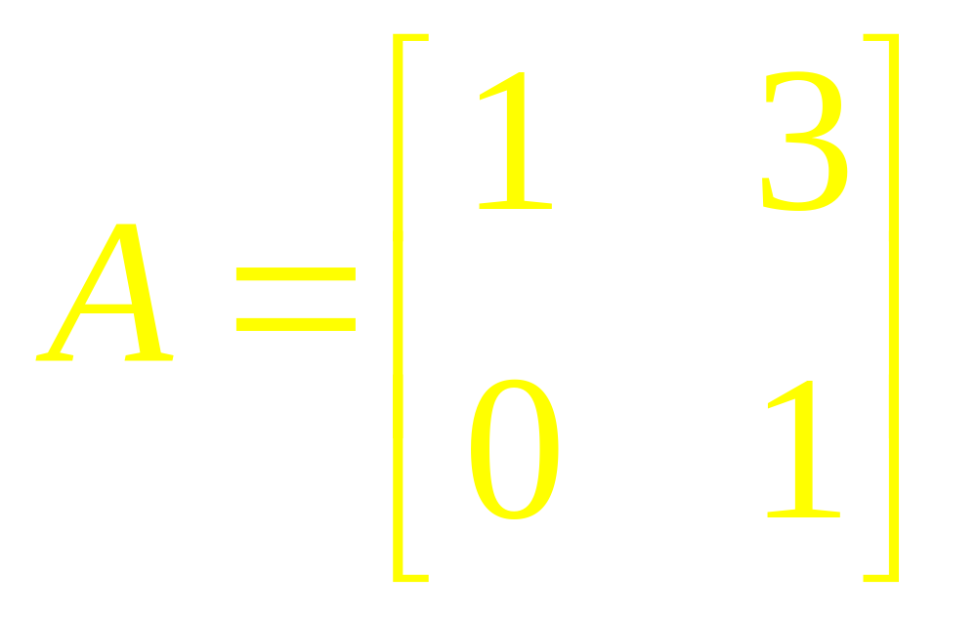
Example 3

Slide 13
Definition
A transformation (or mapping) T is linear if:
T(u + v) = T(u) + T(v) for all u, v in the domain of T;
T(cu) = cT(u) for all u and all scalars c.

Slide 14
Further
If T is a linear transformation, then T(0) = 0, and
T(cu +dv) = cT(u) + dT(v)
for all vectors u, v in the domain of T and all scalars c, d.

Slide 15
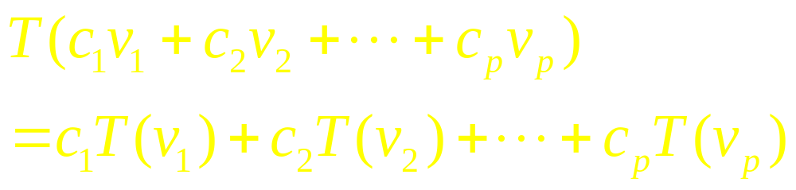
Generally

Slide 16
Examples

Slide 17
Linear Algebra
Lecture 9

